Slide 1
PCS’s Clinical Training in Psychotherapy

Slide 2
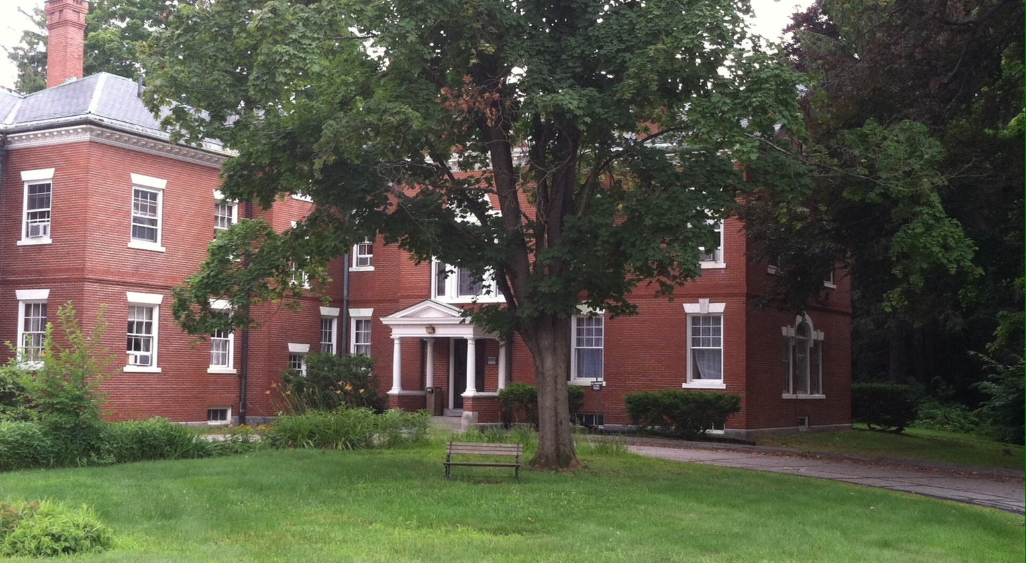
Main Office

Slide 3
Pastoral Counseling Services,Inc.
PCS has been operating since 1979
A Samaritan center located in Manchester, NH
  Satellites in Nashua, Bedford, Portsmouth
16 Full and part-time clinical staff
  Range of theoretical practice orientations
  Therapists 24 average years of practice
4 trainees in clinical psychotherapy program
  Five senior therapists serve as teaching supervisors

Slide 4
Philosophy of Training Program
We practice with the belief that psychological and spiritual health comes from a rich engagement of the individual in mind, body, and spirit with family and the community at-large.
The Training Program is designed to develop professionals in clinical methods of promoting the psychological and spiritual health of their clients.

Slide 5

Mindfulness=Lobster Rolls and Chowdah

Slide 6
Theoretical Orientation of Training Program
Bowen Systems Theory provides the contextual overlay for all studies, equipping trainees to understand the patterns of clients’ interactional dynamics as relates to clinical issues.
Attachment Theory (Bowlby, Ainsworth)
Self Psychology and Relational Theories (Kohut, Stolorow, Mitchell)
Family Systems Theory
  Emotionally Focused Theory
  Structural Family Theory
  Family Assessment Tools (eg, Beavers/Timberlawn)

Slide 7
Format of Training Program
Two tier training
  Graduate Interns enrolled in graduate program for clinical psychology, social work, mental health counseling, marriage and family therapy, or pastoral psychotherapy (all licensed disciplines)
  Postgraduate Residents who have completed their academic program and are pursuing the requisite hours of supervised clinical experience for licensure (usually 3,000 hours)

Slide 8
Goals of Training Program
Interns completing practicum for graduate
programs are expected to know how to
conduct intake interviews, write psycho-
social assessments, construct treatment
plans, and provide basic counseling
services under close supervision
Interns also learn the full scope of what is expected for professional spiritually sensitive psychotherapy practice in a collegial community

Slide 9
Goals of Training Program
Postgraduate Residents
Applications from graduates of over seven graduate schools in the first year of program
Residents must complete first year satisfactorily to be offered the second year, whether half or full-time.
Full-time is 15-20 sessions weekly
Compensation is hourly rate of pay for sessions

Slide 10
Goals of Training Program
Postgraduate Residents
Complete all skills expected of interns
Anticipate accumulation of 3,000 hours of clinical experience (1,000-1,500 direct client)
Demonstrate (live or by taping) intermediate skills in psychotherapy and family therapy before residency completion

Slide 11

It’s Not All Work…

Slide 12
Methods and Scope of Training
Weekly individual supervision (1-2 hours
dependent upon client hours ratio)
Weekly group supervision (90 minutes)
Weekly seminar on theory and application
including professional ethics and
and spirituality in psychotherapy
Utilization of tape review or live supervision

Slide 13
Benefits of Program for PCS
Expanded offering of adjusted fee counseling
Reduced need to raise contributions for client assistance fund
Opportunity to see develop the qualities and potentials of trainees as future PCS staff therapists
  Ability to work within unique clinical context
  Ability to provide spiritually sensitive psychotherapy for individuals and families
  Appreciation of not-for-profit context of services

Slide 14
Faculty Supervisors
Cal Genzel, Ph.D., LP
David Reynolds, D.Min., LPP
Douglas Stephens, Ed.D., LICSW,LMFT,BCD
Audrey Watjen, LICSW
Cathy Youkstetter, LMHC

Slide 15
Contact
Pastoral Counseling Services, Inc.
  2013 Elm Street, Manning House
  Manchester, New Hampshire 03104
  603-627-2702
  Doug Stephens, Ed.D. Training Coordinator
  ext. 117 dstephens@pcs-nh.org
  www.pcs-nh.org

